Slide 1
Jason Kopylec
Vikram Nayak
Xiaotian Xu
Lei Shi
Harsh Patel
Grouper
Focus on Teaching!
SLC Camp | Oct. 21st 2012

Slide 2
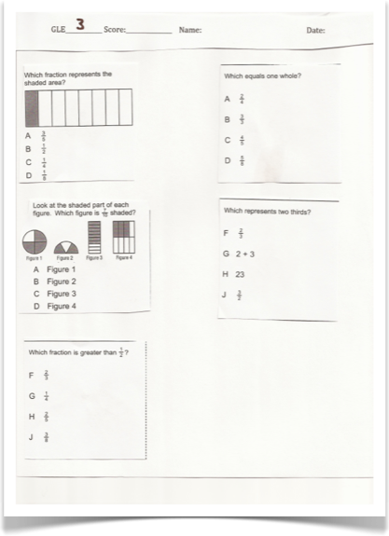
Teacher gives a fractions test (assessment)

Slide 3
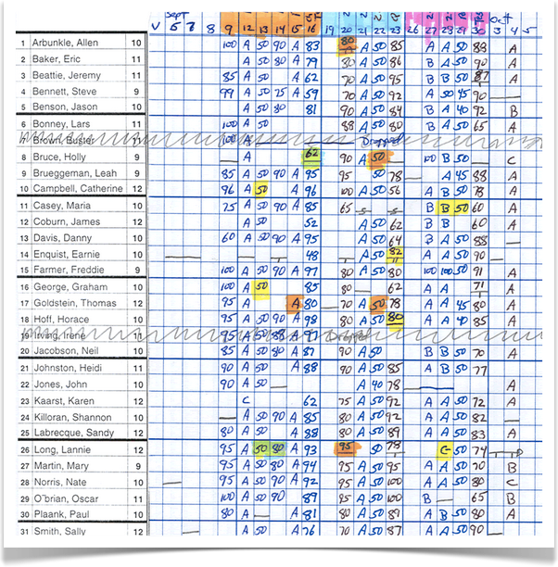
Kids get grades on their fractions test
A’s B’s C’s D’s and F’s
Notes:
More often than not, right after giving kids grades. Teachers will say, ok cool! Next unit. Decimals!

Slide 4

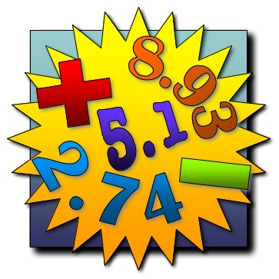
Next Unit: Decimals!

Slide 5












Wait...
What about the C’s, D’s, and F’s??
Notes:
What about all the kids who got C’s D’s and F’s. They are confused on something, and won’t be able to get help. They’re stuck. These kids will keep failing on decimals, then on and on and on, until they hate math and never go into STEM (science technology engineering or math) fields. epic fail on the education system’s part.

Slide 6
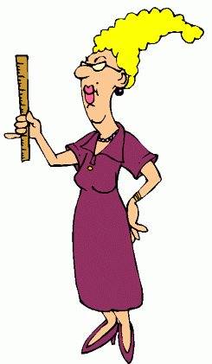
Why does this happen?
“It’s pretty confusing to import, format, sort, and group all this data for 64+ students.”
“I don’t have time to sift through all the data.”
Notes:
If we can prevent this, more students will be more successful in math, or english or whatever test they just took. They’ll go into STEM, and create a time machine.

Slide 7
How often does this happen?
Multiple times a month.

Slide 8
Thanks to the SLC & Grouper...

Slide 9
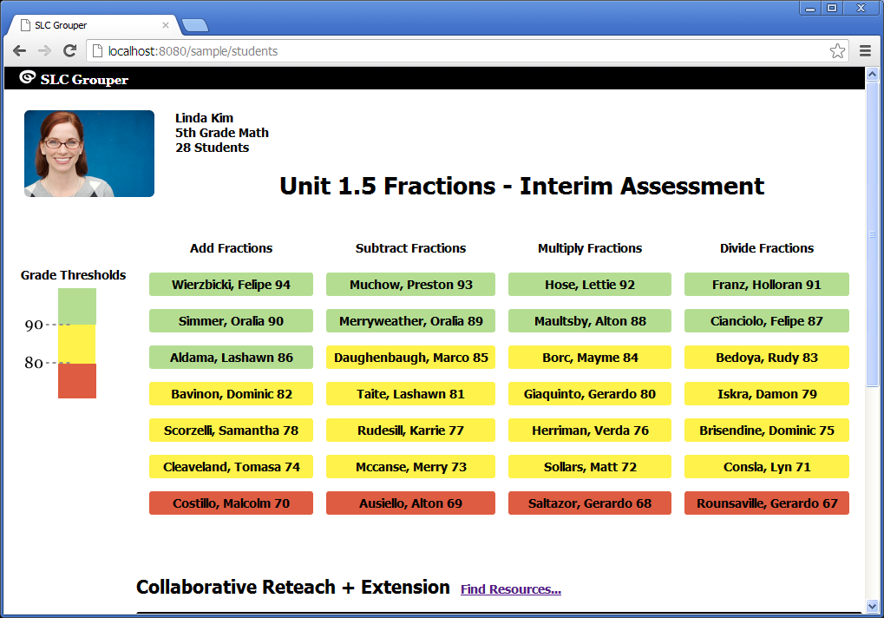

Slide 11
Data Model
Learning Objective
Learning Standard
Assessment
AssessmentItem
Student
AssessmentAssociation
Student
AssessmentItem
Student

Slide 12
Thank You.
Questions?

